Slide 1
Why Software Goes Bad & How to Fix it
Writing the right code right

Slide 2
About Me
Me
Work
Keith Harrison
Software Developer @ JP Morgan
25 Years Experience
Community
Tech Meetup
CodeCraft
Rookie Oven

Slide 3
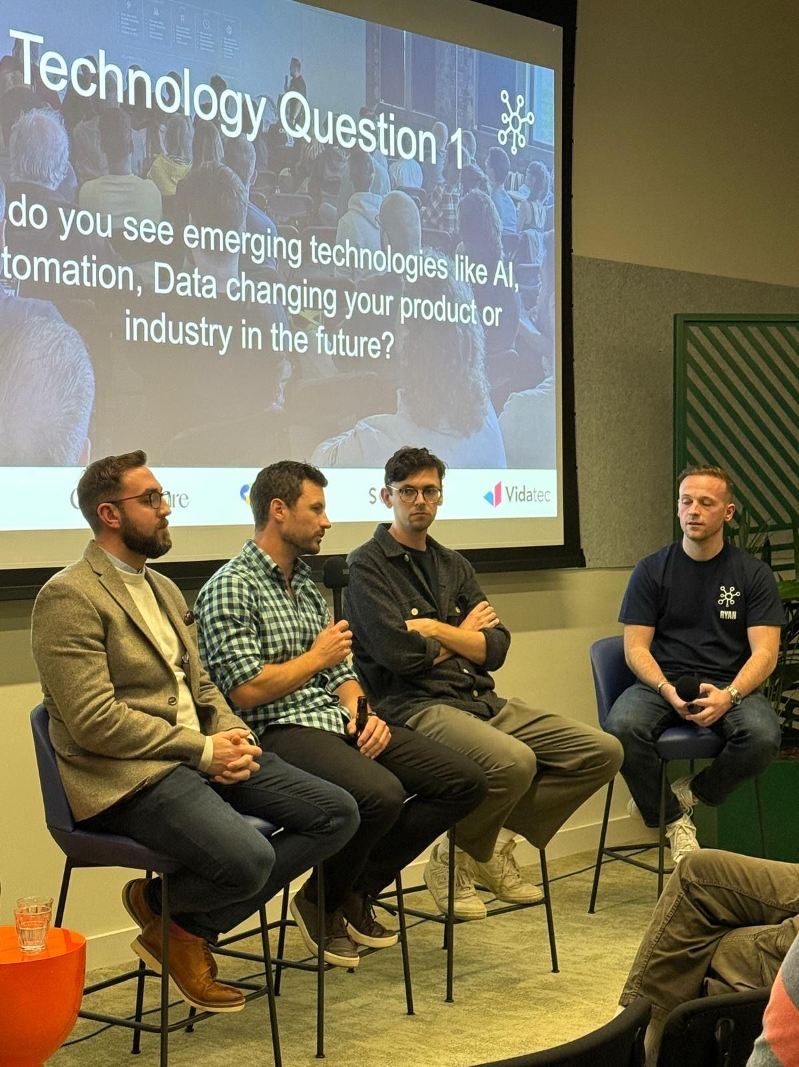
Notes:
October Tech Meetup
Craig Letton
CEO of Hyble
1 Week outage
Additional time dealing with technical debt
Ryan Canning
Ryan Findlay

Slide 4

$2.41 Trillion
$1.52 Trillion
6% GDP
Total cost of poor software quality
Directly attributable to technical debt
Equivalent share of the U.S. economy
Source: https://www.it-cisq.org/wp-content/uploads/sites/6/2022/11/CPSQ-Report-Nov-22-2.pdf

Slide 5
Without Best Practice
Feature 1 | Feature 2 | Feature 3 | TOTAL
£100,000 | £200,000 | £400,000 | £700,000

Slide 6
With Best Practice
Feature 1 | Feature 2 | Feature 3 | TOTAL
£110,000 | £110,000 | £110,000 | £330,000

Slide 7
Software Development in a Nutshell
01
02
Build the right thing
Build it right

Slide 8
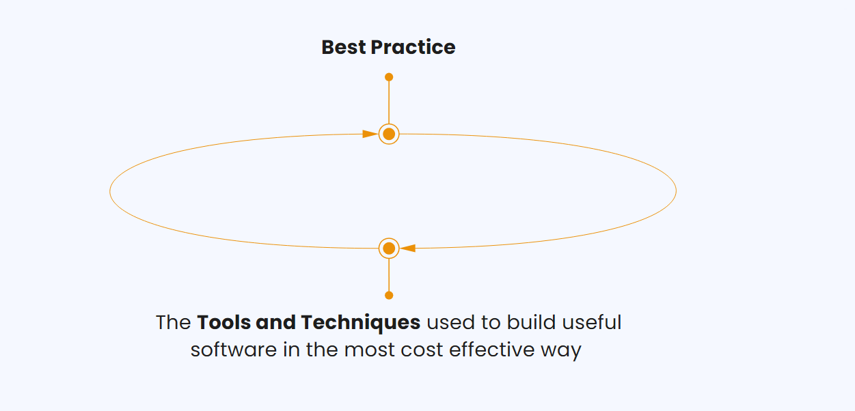
What is Best Practice?

Slide 9
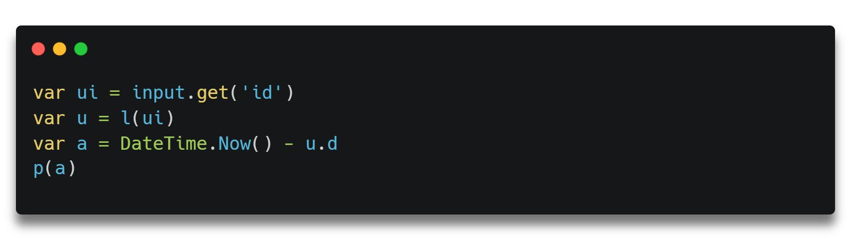
Naming
Notes:
https://carbon.now.sh/?bg=rgba%28255%2C255%2C255%2C1%29&t=seti&wt=none&l=text%2Fx-csharp&width=800&ds=true&dsyoff=10px&dsblur=9px&wc=true&wa=false&pv=24px&ph=15px&ln=false&fl=1&fm=Hack&fs=17px&lh=140%25&si=false&es=2x&wm=false&code=var%2520ui%2520%253D%2520input.get%28%27id%27%29%250Avar%2520u%2520%253D%2520l%28ui%29%250Avar%2520a%2520%253D%2520DateTime.Now%28%29%2520-%2520u.d%250Ap%28a%29%250A

Slide 10
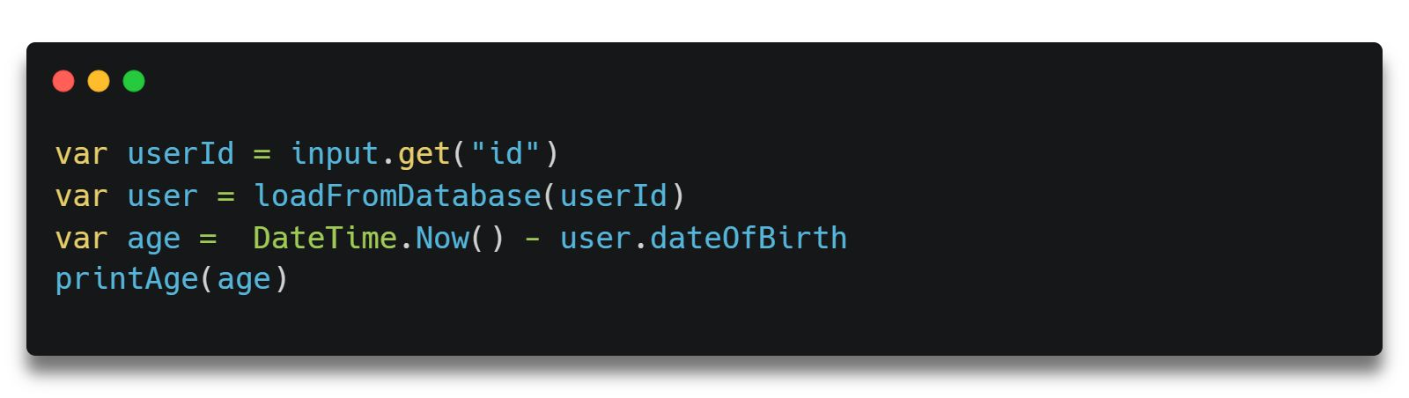
Naming
Notes:
https://carbon.now.sh/?bg=rgba%28255%2C255%2C255%2C1%29&t=seti&wt=none&l=text%2Fx-csharp&width=800&ds=true&dsyoff=10px&dsblur=9px&wc=true&wa=false&pv=24px&ph=15px&ln=false&fl=1&fm=Hack&fs=17px&lh=140%25&si=false&es=2x&wm=false&code=var%2520userId%2520%253D%2520input.get%28%2522id%2522%29%250Avar%2520user%2520%253D%2520loadFromDatabase%28userId%29%250Avar%2520age%2520%253D%2520%2520DateTime.Now%28%29%2520-%2520user.dateOfBirth%250AprintAge%28age%29%250A

Slide 11
Functions
Find the bug...
Find the bug...
Notes:
Business perspective?

Slide 12
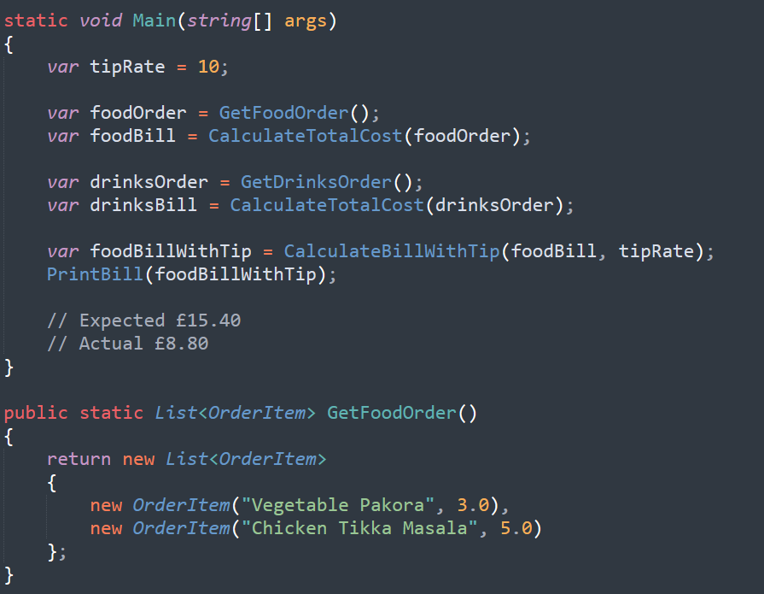
Notes:
Business perspective?

Slide 13
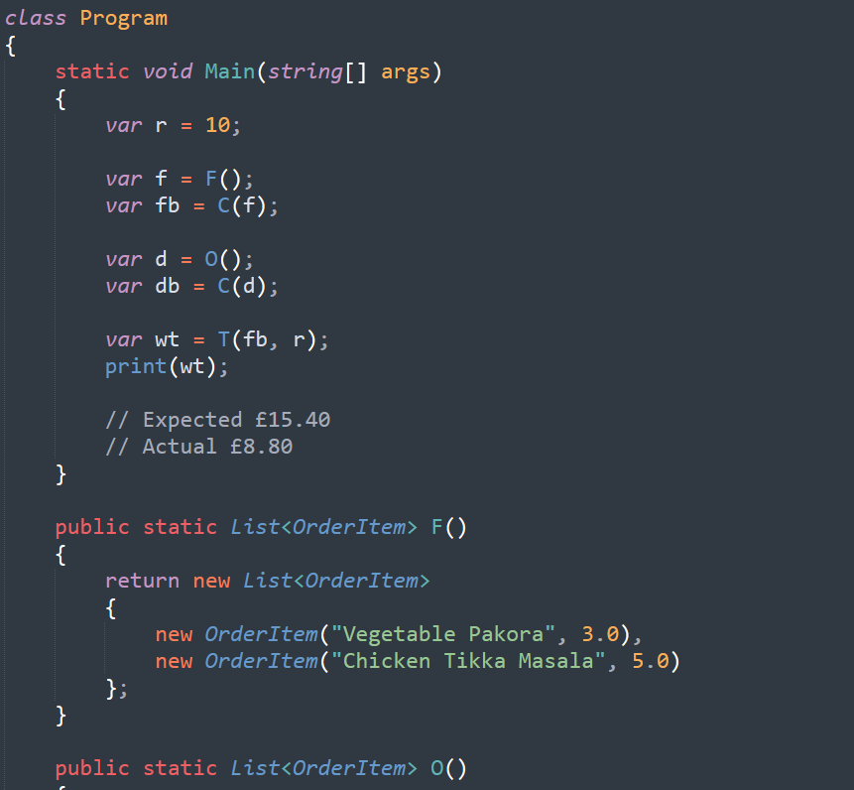
Notes:
Business perspective?

Slide 14
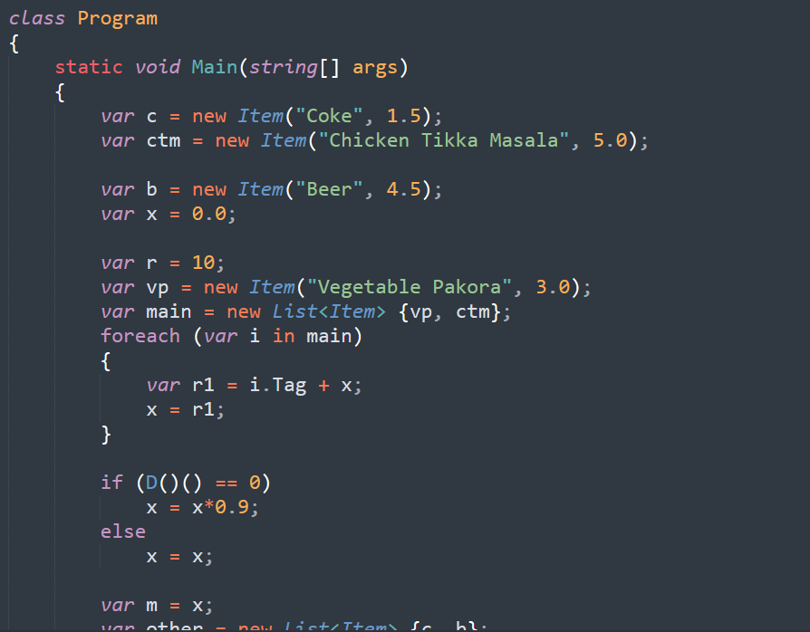
Notes:
Business perspective?

Slide 15
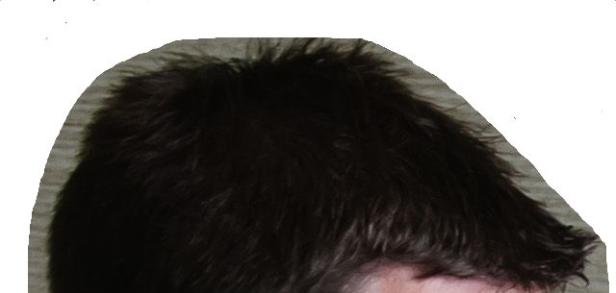
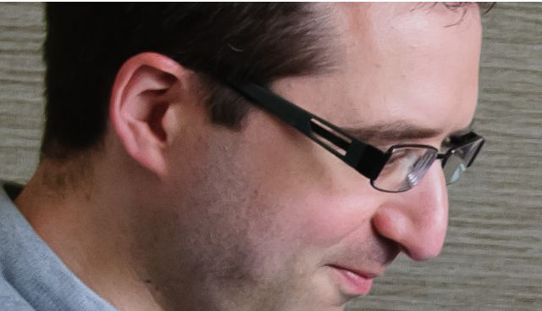
Func1()
var1
Func4()
var3
Func3()
var2
Func2()

Slide 16
Stucture
System
Services
UI
UI
UI
UI
UI
UI
UI
Payment
Service
Service
Service
Order
DB
DB
DB
Account
Notes:
2nd law of thermodynamics
Bran Cox
Put in effort
Refactoring board

Slide 17
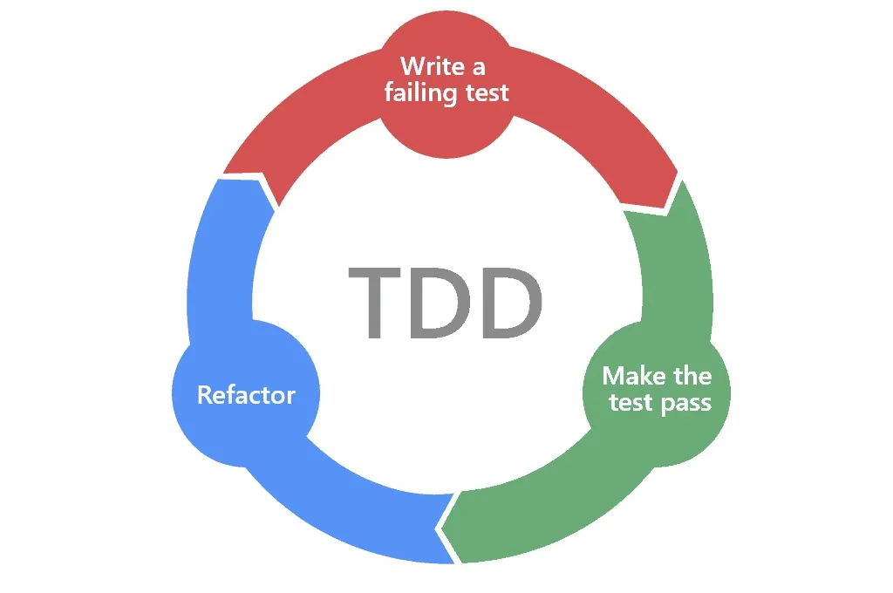
Test Driven Development
Notes:
- Glasgow Software Development Best Practice Meetup – GlaSoDeBePraMe
- https://www.linkedin.com/groups/16095186/
- https://luma.com/wh9kn7b1
- 21st January, 6:30pm - 8:30pm https://www.thegamerclub.co.uk/

Slide 18
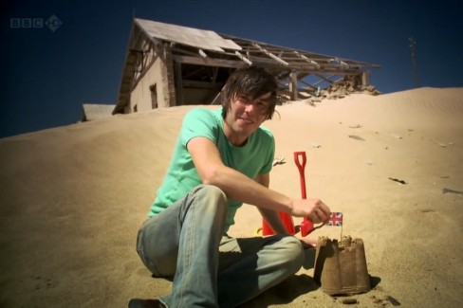
Software Entropy
Notes:
2nd law of thermodynamics
Bran Cox
Put in effort
Refactoring board

Slide 19
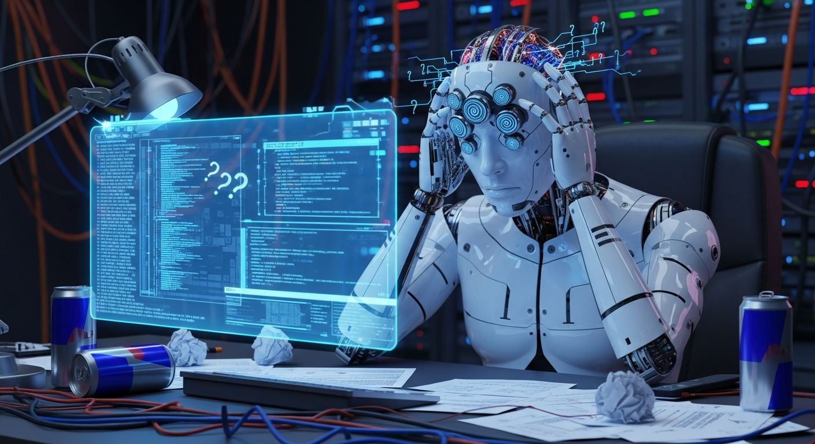

Best Practice and AI

Slide 20
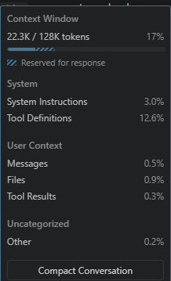
Best Practice and AI

Slide 21
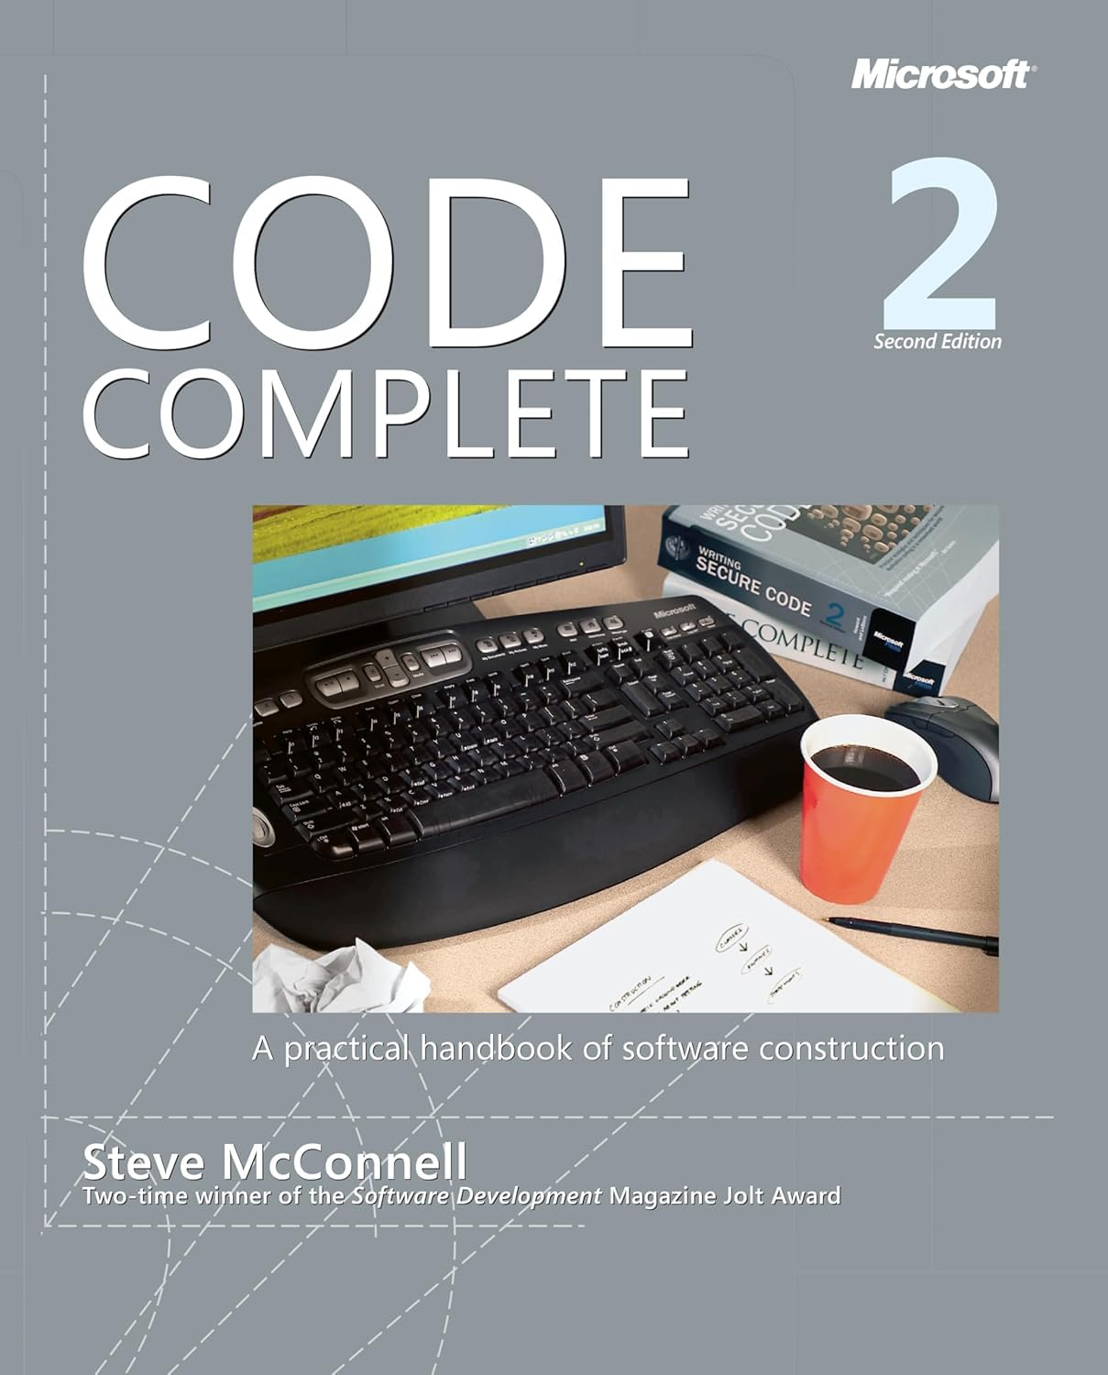
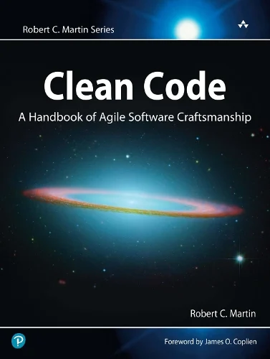

Learn More...
Notes:
- Glasgow Software Development Best Practice Meetup – GlaSoDeBePraMe
- https://www.linkedin.com/groups/16095186/
- https://luma.com/wh9kn7b1
- 21st January, 6:30pm - 8:30pm https://www.thegamerclub.co.uk/

Slide 22
Summary
Build the right thing
Best Practice is the most effective way
You brain has limited context
AI is more productice with Best Practice
Clean Code / TDD
Notes:
- Glasgow Software Development Best Practice Meetup – GlaSoDeBePraMe
- https://www.linkedin.com/groups/16095186/
- https://luma.com/wh9kn7b1
- 21st January, 6:30pm - 8:30pm https://www.thegamerclub.co.uk/

Slide 23
Questions?

